Slide 1
Two stroke and four stroke engines
A two stroke engine has the cycle duration of one revolution of the crank i.e. 360⁰ with one power stroke (0⁰ to 180⁰, when piston moves from IDC to ODC) and one exhaust/intake stroke (180⁰ to 360⁰, when piston moves back from ODC to IDC).
A four stroke engine has the cycle duration of two revolutions of the crank i.e. 720⁰ with one power stroke (0⁰ to 180⁰, when piston moves from IDC to ODC), followed by the three subsequent strokes, namely, exhaust stroke (180⁰ to 360⁰, when piston moves back from ODC to IDC), suction stroke (360⁰ to 540⁰, when piston moves from IDC to ODC) and compression stroke (540⁰ to 720⁰, when piston again moves back from ODC to IDC) in cyclic order. Practically, the gauge pressure within the cylinder is almost zero during exhaust and suction strokes.
**Know about SI and CI engines (though not within present scope)

Slide 2
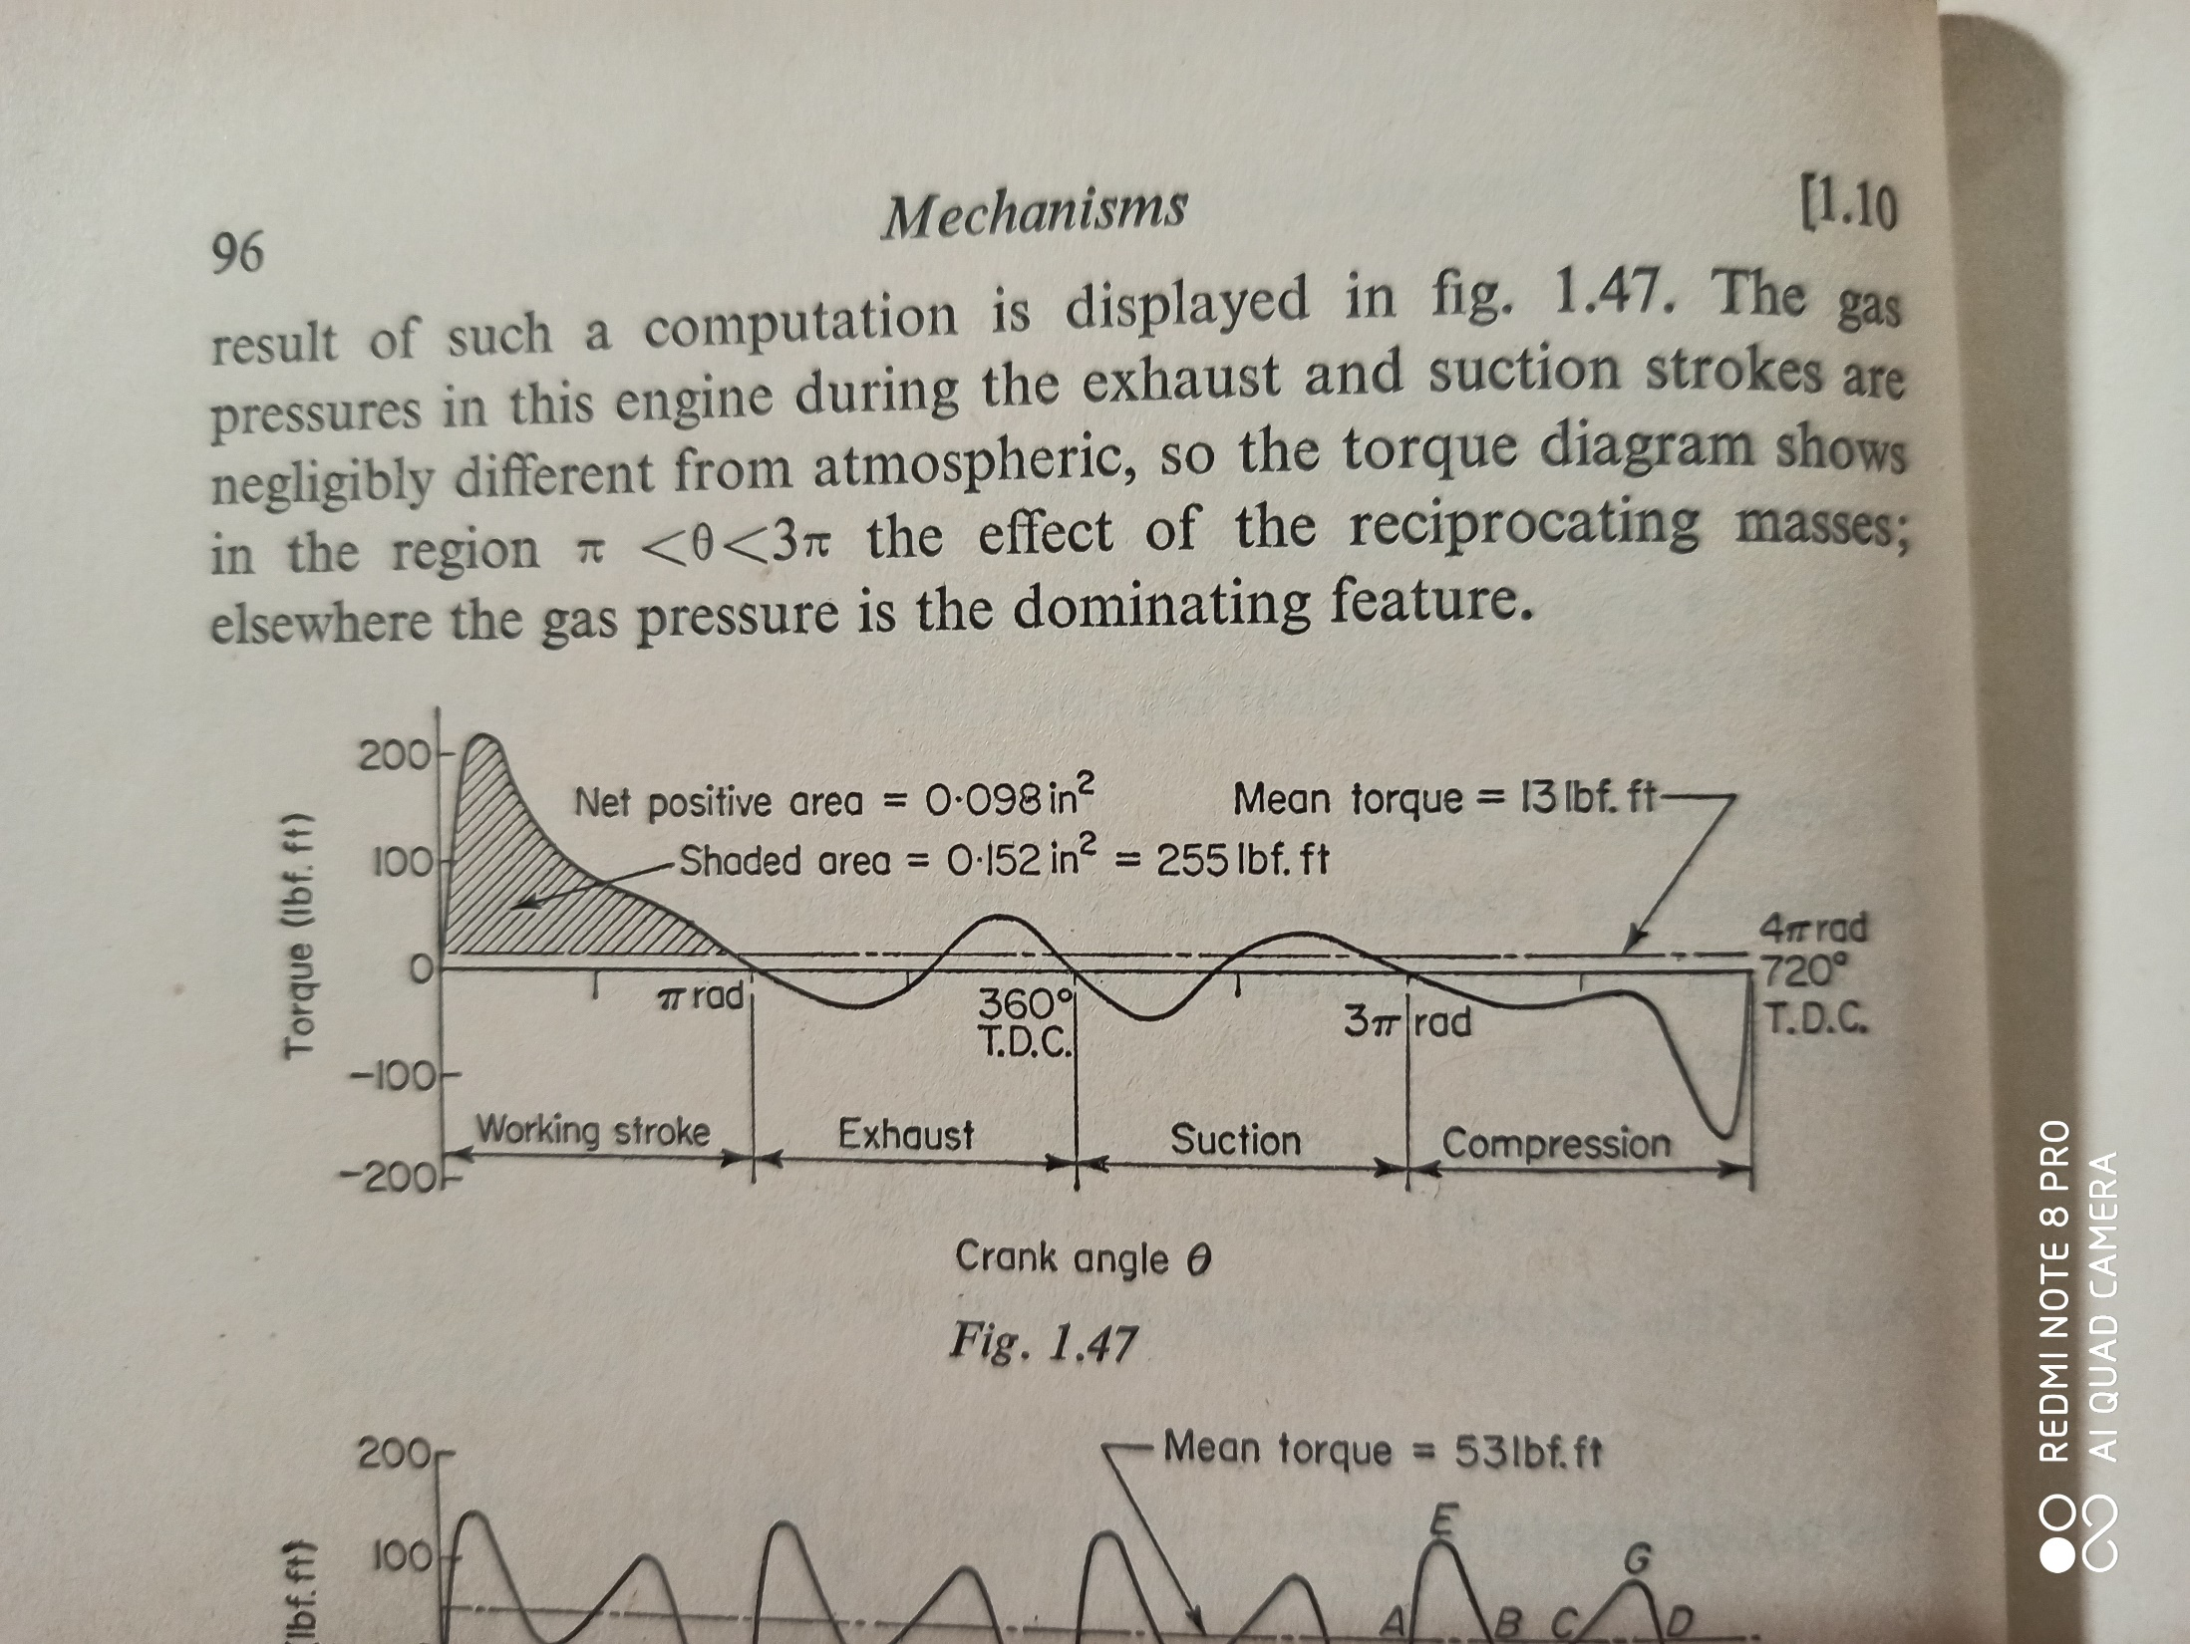
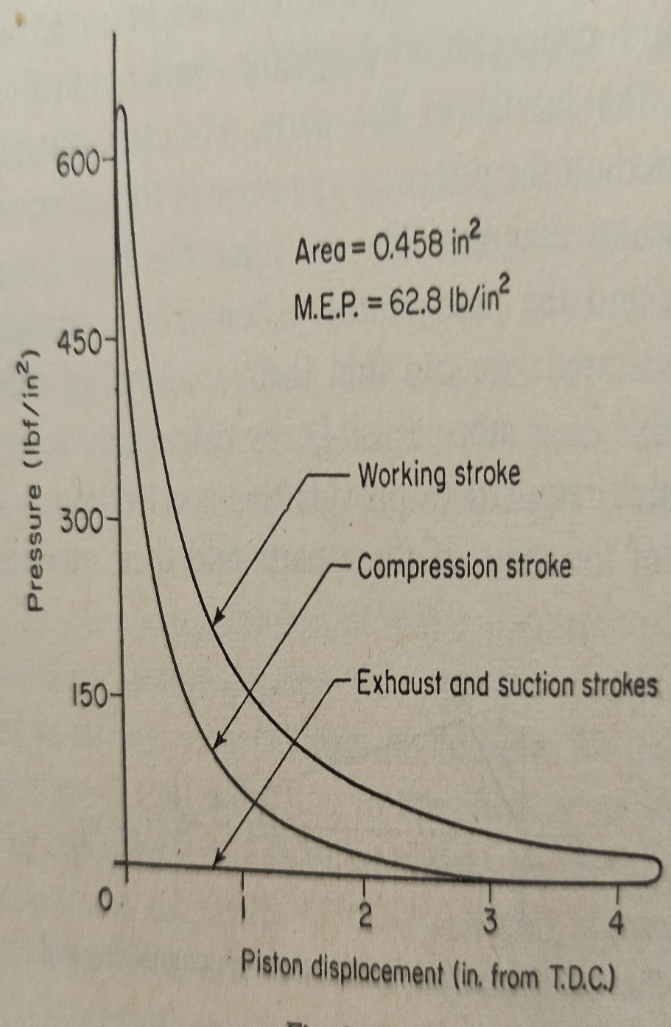
Turning Moment Diagram and Flywheel
Indicator Diagram | Turning Moment Diagram for a 4-stroke Petrol Engine

Slide 3
Important terms connected to Turning Moment Diagram
Work done/cycle = ∮Tdθ where duration of the usual cycle is one revolution (2π) or two revolutions (4π) for 2-stroke or 4-stroke engine respectively (in Joule)
Work done/revolution = (Work done/cycle)/(number of revolutions per cycle) (in Joule)
where the duration of the cycle is in radian
Mean Torque T_{m} = (Work done/cycle)/duration of the cycle
= (Work done/revolution)/(2π) in Nm
Power of the engine = ω_{m}T_{m}=2πNT_{m}/60 in Watt, where ω_{m} is mean speed and N is rpm
Fluctuation of energy E_{f} = maximum shaded area above the T_{m} line in T-θ diagram
= ʃ(T-T_{m})dθ where integration limits θ₁ and θ₂ are intersection points between the T_{m} line and T-curve in T-θ diagram
Coefficient of fluctuation of energy K_{e} = fluctuation of energy/(Work done/cycle)
If in the T-θ diagram there are several areas above T_{m}-line, the maximum area (shaded) is to be considered for the estimation of Fluctuation of energy. Intersection points θ₁ and θ₂ correspond to minimum and maximum speeds ω₁ and ω₂ within the operational cycle.
Thus, Coefficient of fluctuation of speed K_{s} = (ω₂ - ω₁)/ω_{m} where ω_{m} =(ω₂+ω₂)/2

Slide 4
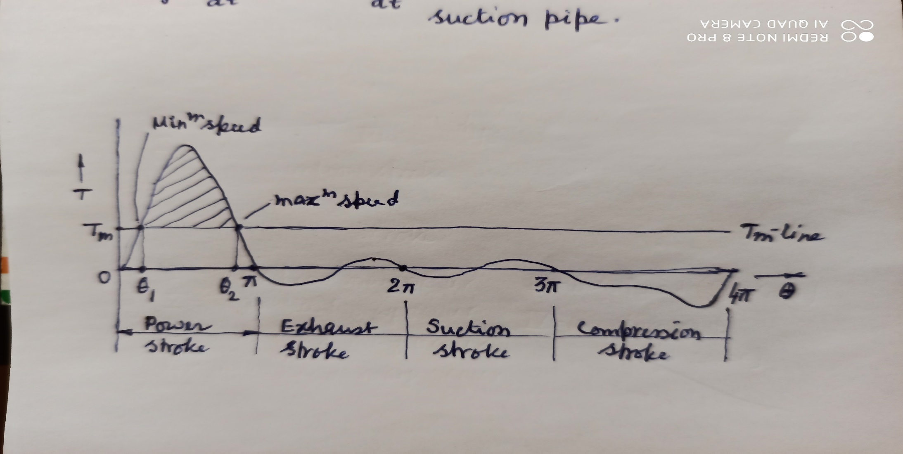
Flywheel and Fluctuation of Energy from T-θ Diagram
A flywheel is a device for reducing to acceptable proportions the cyclic variation in speed of a machine. It acts as an accumulator for storing excess energy (fluctuation of energy), in the form of rotational kinetic energy, usually produced during the power stroke and releases that stored energy during the idle stroke/s of the operational cycle to maintain the cyclic speed fluctuation within a prescribed limit. Thus, E_{f} = I(ω₂² - ω₁²)/2 = I(ω₂-ω₁)(ω₂+ ω₁)/2 = IK_{s}ω_{m}² where I is the moment of inertia of the flywheel. Magnitude (say c) of the coefficient of fluctuation of speed K_{s} = (ω₂-ω₁)/ω_{m} and if it’s magnitude is ‘c’ then it is expressed in either of the form of: c, 100c %, +/- 0.5c, +/- 50c %.

